Slide 1

Multiple Linear Regression
Presented by:
Elizer Ponio Jr.
Department of Computer Science
College of Computing and Information Technologies

Slide 2
Outline
What is Multiple Linear Regression?
Understanding Multiple Linear Regression
Gradient Descent for Multiple Linear Regression

Slide 3
Multiple Linear Regression
Multiple Linear Regression determines the relationship between a dependent variable or two or more independent variables.
The independent variables can be either continuous or categorical

Slide 4
Multiple Linear Regression
Multiple Linear Regression determines the relationship between a dependent variable or two or more independent variables.
The independent variables can be either continuous or categorical

Slide 5





Example: House Price Prediction
Independent Variables
Dependent Variables
Price
Number of Bedrooms
In a mainroad?
Airconditioned?

Slide 6




Example: Company Profit Prediction
Independent Variables
Dependent Variables
Profit
Research and Development
Administration
Marketing

Slide 7
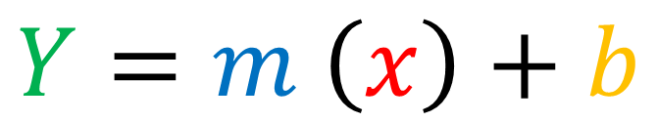
Example: Company Profit Prediction
Simple Linear Regression
$$Y=m \left(x\right)+b$$
Multiple Linear Regression
$$Y=m_{1}(x_{1})+m_{2}(x_{2})+{…+m}_{n}(x_{n})+b$$

Slide 8
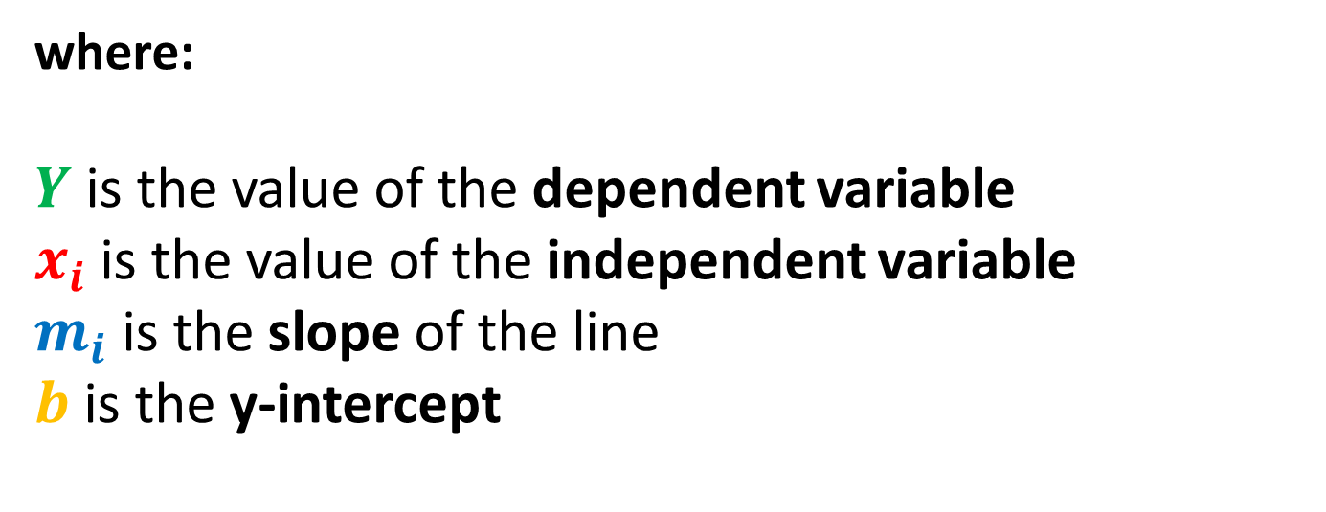
Example: Company Profit Prediction
$$Y=m_{1}(x_{1})+m_{2}(x_{2})+{…+m}_{n}(x_{n})+b$$
where:
$Y$ is the value of the dependent variable
$x_{i}$ is the value of the independent variable
$m_{i}$ is the slope of the line
$b$ is the y-intercept

Slide 9

$$Y=m_{1}(x_{1})+m_{2}(x_{2})+{…+m}_{n}(x_{n})+b$$
where:
$Y$ is the value of the dependent variable
$x_{i}$ is the value of the independent variable
$m_{i}$ is the slope of the line
$b$ is the y-intercept

Slide 10
Example: Company Profit Prediction

